Slide 1

Project Title –:Analysing Airbnb Listing Prices and accomodations
Khushi Bhardwaj
INTERNSHIP_17546440516895be537820f

Slide 2

PROBLEM STATEMENT
Pricing an Airbnb listing effectively is essential for hosts to maximize revenue and maintain high occupancy rates, while also ensuring competitive pricing for travelers. However, determining the optimal price is complex due to numerous influencing factors such as location, amenities, guest ratings, and seasonal trends. This project aims to develop a machine learning regression model that analyzes historical Airbnb data to identify patterns and relationships between listing attributes and price. By accurately predicting listing prices, the model can assist property owners in setting informed and competitive pricing for new or existing listings.

Slide 3
Project Description the project focuses on building a machine learning model to predict the price of Airbnb listings. Pricing an Airbnb property correctly is crucial for hosts and travellers :hosts want to maximise earnings and occupancy.
Using historical Airbnb data, the project develops a regression model that Airbnb between listing attributes(such as number of hosts want guest ratings) and the price charged.
The model can then be used to predict prices for new are hypothetical listings, helping property owners make informed pricing decisions.

Slide 4

WHO ARE THE END USERS?
Airbnb hosts
To optimise pricing of their listings based on property features and guest reviews.
Travelers
To evaluate whether a listing is overpriced or reasonably priced
Airbnb platform analysts
To improve automated pricing suggestions and increase platform trust
Researchers students
To study the impact of propitiators and reviews on rental pricing.

Slide 5

Technology Used
  Python :core programming language
  Pandas and NumPy : data cleaning and preprocessing
  Scikit-learn :machine learning (model model)
  Matplotlib/seaborn : data visualization nnd feature importance
  Google colab : cloud based environment for running the project
  File handling libraries ; openpyxl(for excel) and built-in csv handling

Slide 6
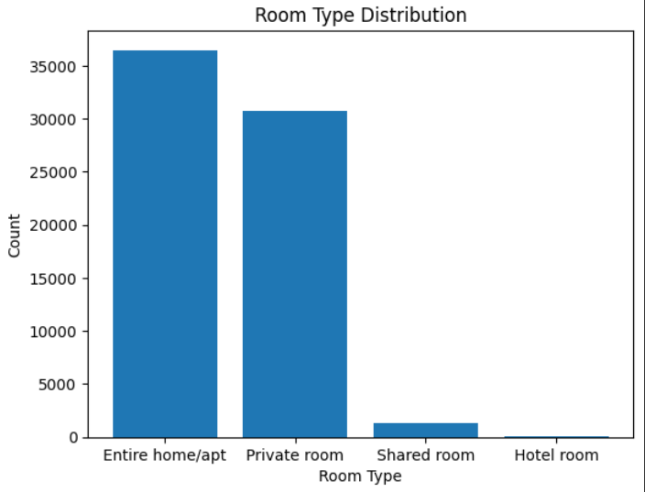
RESULTS1
Demo Link

Slide 7
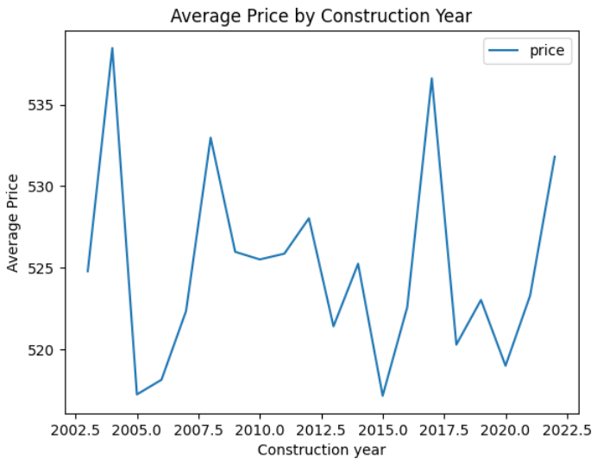
RESULTS2
Demo Link

Slide 8
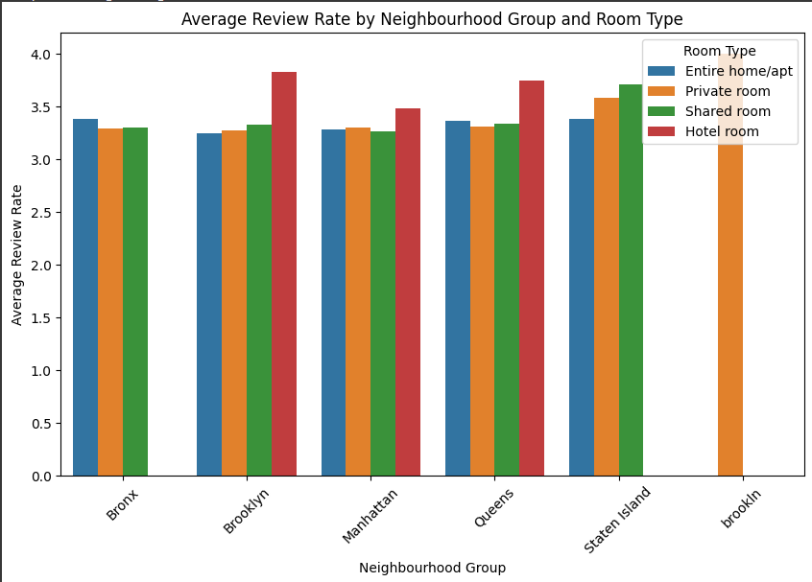
RESULTS3
Demo Link

Slide 9
GitHub repository
https://github.com/KhushiB03/VOIS_AICTE_Oct2025_KhushiBhardwaj
Demo Link

Slide 10
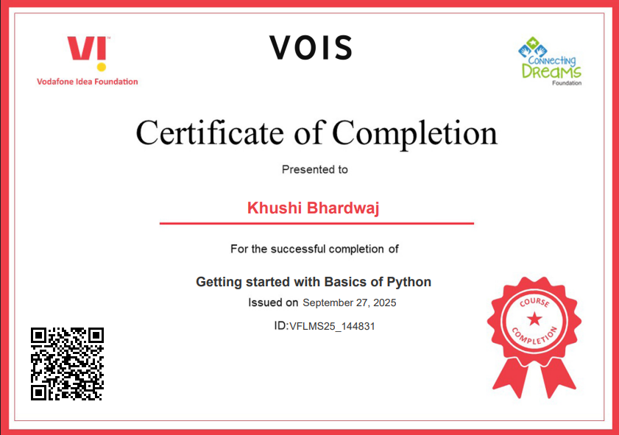
Getting started with Basics of Python Certificate

Slide 11
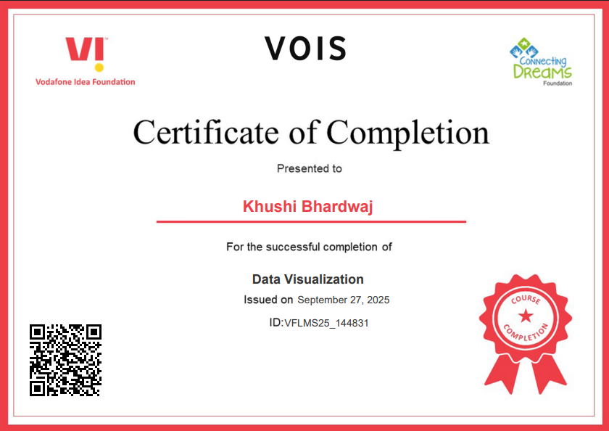
Data Visualization Certificate

Slide 12
Thank you
.
.

